Slide 1

DEHAZE: AI-POWERED IMAGE DEHAZING USING DEEP LEARNING
Group ID: Ecs _45
Branch: Electronics & Computer Science Engineering
Team Members:
Arnav Singhal — 2330293
Abhishek Kumar Singh — 2330207
Anushka Sharma — 2330291
Bhavya Suman — 2330298
Supervisors: Prof. Suprava Patnaik
School of Electronics Engineering
KIIT Deemed to be University, Bhubaneswar

Slide 2
Objective
What This Project Aims to Do
Implement dehazing using pre-trained MAXIM-S2 + lightweight adapter head (~11K params)
Build a tiled inference engine for arbitrary high-resolution image processing
Develop a FastAPI backend with REST endpoints for dehazing + quality metrics (PSNR, SSIM, MSE)
Create a React frontend with drag-and-drop UI and before/after comparison
Evaluate on SOTS outdoor benchmark — quantitative + qualitative
Enable local/offline deployment — no cloud dependency, data privacy preserved
Design a modular, extensible architecture for future enhancements

Slide 3
Innovation in the project
1. Adapter Head with Zero-Initialization
The most novel part — instead of fine-tuning the entire MAXIM-S2 model (2.7M params), you appended a tiny 11,043-parameter residual correction network that:
Starts at zero weights → outputs zero at epoch 0 → system behaves exactly like the backbone initially
Gradually learns only the corrections needed, not the full dehazing task
Achieves strong results on just 413 training pairs without overfitting.
2. Tiled Inference Engine
Most dehazing research evaluates only on fixed 256×256 images. Your system:
Handles arbitrary resolution inputs (including 4K)
Decomposes → processes → reconstructs without resizing or quality loss
Manages GPU memory constraints automatically

Slide 4
3. Combined L1 + SSIM Loss
Rather than standard pixel-loss training:
L1 ensures pixel accuracy
SSIM term explicitly optimizes for human perceptual quality — edges, texture, structure
Result: sharper, more natural outputs vs. L1-only blurry outputs
4. Full-Stack Locally Deployable System
Most dehazing work stops at a model checkpoint. Yours delivers:
A complete production-ready web app (FastAPI + React)
No cloud dependency — runs fully offline
Accessible to non-technical users via drag-and-drop UI
Built-in quantitative evaluation (PSNR/SSIM/MSE) within the UI itself
5. Efficient Transfer Learning on Minimal Data
Training a high-quality dehazing model from scratch needs thousands of images and heavy compute. Your approach achieves competitive PSNR (24–30 dB) with:
Only 413 image pairs
Only 11K trainable parameters
Trainable on a consumer CPU (no expensive GPU required)

Slide 5
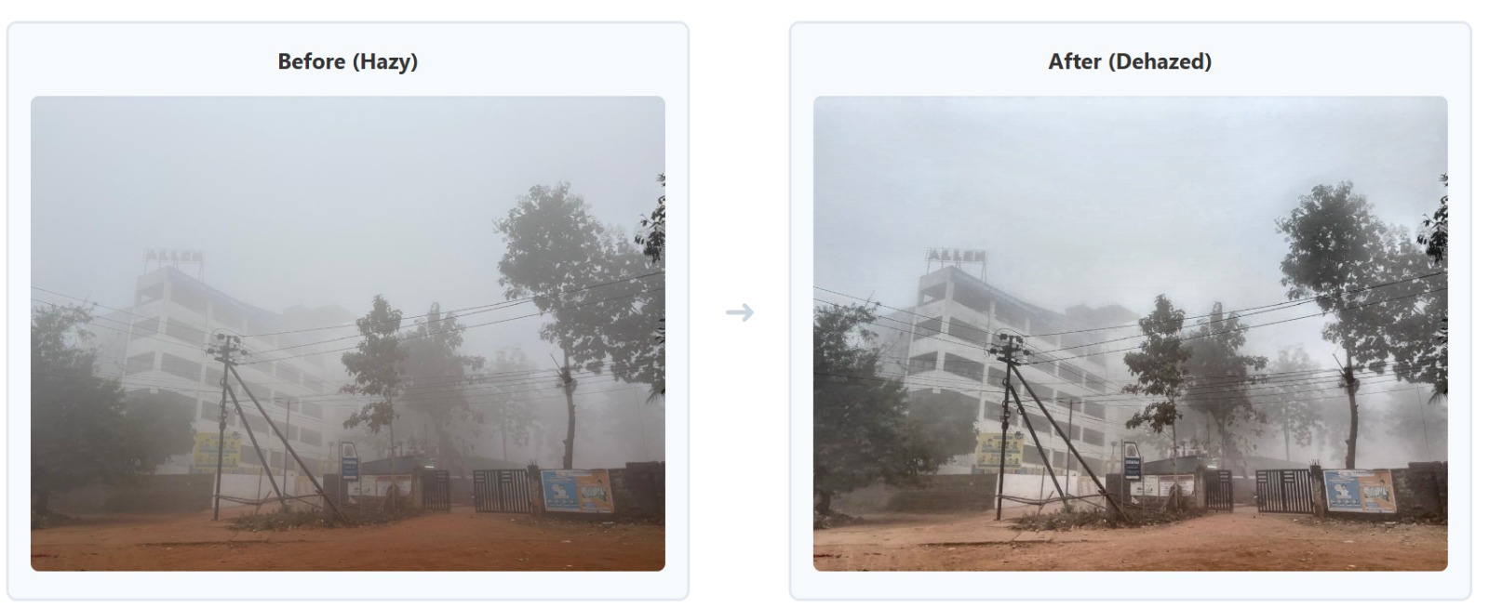
Experimental Prototype

Slide 6
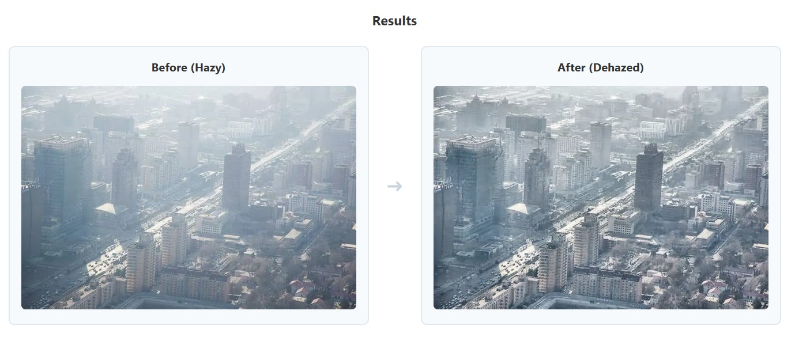

Slide 7
Result
Performance on SOTS Outdoor Validation Set
Metric | Hazy vs Ground Truth (Baseline) | Dehazed vs Ground Truth (Our Output) | Improvement
PSNR (dB) | 15–20 dB | 24–30 dB | +8–12 dB
SSIM | 0.60–0.75 | 0.88–0.95 | +0.15–0.20
MSE | 250–500 | 50–120 | ~5× reduction

Slide 8
Challenges & Solutions
Challenge | Solution
Model trained only on 256×256 | Tiled inference engine
Slow model loading (~2–3s) | Load once at startup, cache in memory
CORS blocked in local dev | CORS Middleware with allow_origins=["*"]
Random adapter init causes instability | Zero-weight initialization
GPU memory limits for large images | Tile-by-tile processing
Diverse input formats | Standardized RGB preprocessing pipeline

Slide 9
Conclusion
What Was Achieved
PSNR improved by 8–12 dB, SSIM by 0.15–0.20 over hazy baseline
Only ~11K trainable parameters — efficient, no overfitting on 413 pairs
Tiled inference handles arbitrary resolution (including 4K)
Full-stack app accessible to non-technical users
Local/offline deployment — no cloud, no data privacy risk
~2,685 lines of production code across 19 files, MIT Licensed

Slide 10
References(in IEEE format)
Tu et al., "MAXIM: Multi-Axis MLP for Image Processing," CVPR 2022
He et al., "Single Image Haze Removal Using Dark Channel Prior," IEEE TPAMI, 2011
Cai et al., "DehazeNet," IEEE TIP, 2016
Li et al., "RESIDE Benchmark," IEEE TIP, 2019
Hu et al., "LoRA," ICLR 2022
Wang et al., "SSIM," IEEE TIP, 2004
Google Research, MAXIM-S2 on Hugging Face, 2022

